Slide 2
Legislative Committee
NOW: Co-Chair Shay Odom - Ch13, Dept 1JVC Rich Lehmann
LATER: BPTL/Co-Chair Shamala Capizzi - Ch10, PDC Denice Williams - Ch22
STATED GOALS
Increase DAV Commander’s Action Network participation
Increase the number of Chapters that submit Resolutions (current/new)
Communicate important legislative information to the Membership
Deliver DAV Critical Policy Goals to Senators and Representatives
Department of Virginia 2020

Slide 3
DAV Resolutions
Department of Virginia 2020

Slide 4
INTRODUCTION
WHY ARE RESOLUTIONS SO IMPORTANT?
It wasn’t that long ago that we were fighting to get benefits for –
Presumptive conditions in the PACT Act
Agent Orange coverage for the brown water and blue water navy
QUESTION: WHAT ARE SOME OTHER BENEFITS THAT WE RECENTLY ACHIEVED?
WE REAP THE BENEFITS OF THE EFFORTS
OF OUR COMRADES WHO CAME BEFORE US!

Slide 5
INTRODUCTION
WHY DO WE ENCOURAGE CHAPTERS TO SUBMIT RESOLUTIONS?
DAV can only support or oppose legislation/policies on issues that have adopted resolutions from our most recent national convention.
Chapters, Dept Committees, and Departments can write resolutions.
Resolutions can involve issues locally, at the state or federal/national level.
They require approval at each level.
KEY TAKEAWAYS
AT THE END OF THIS TRAINING, YOU WILL –
Understand the resolution process
Know the resources that are available to assist you in researching

Slide 6
INTRODUCTION
SECTION 1-6: RULES OF THE CONVENTION - Rule 7:
Resolutions shall be submitted in electronic form, signed by the sponsoring Chapter or Department Committee, no later than 14 days prior to the Department Convention (May 23).
Resolutions will be forwarded to the Resolution Committee for review prior to the opening session of the Department Convention.
All national or federal resolutions approved by the department must be submitted to the National Legislative Director 14 days prior to the national convention.

Slide 7
INTRODUCTION

Slide 8
RESOLUTION RESOURCES
DAV.ORG/ABOUT-DAV/LEGISLATION
2023-2024 Legislative Program (Resolutions) – 278 pages
Before you start, read the DAV Statement of Policy (Resolution 1).
This defines the DAV mission and will help keep your resolutions on point.

Slide 9
RESOLUTION RESOURCES
Download Adobe Acrobat Reader (if you need to)
Use the Magnifying Glass or “CTRL F” to find key terms – McClellan, Burn Pits, Toxic Exposure, Tinnitus, Herbicide, Hearing, Military Sexual Trauma (MST), Entrepreneurship, Women
If you need assistance with your resolutions at the Chapter, Dept Committee or Department level, please reach out to the National Legislative Department for assistance: 202-554-3501

Slide 10
WRITING A RESOLUTION
The easiest way to understand a Resolution is to first break it down into its three component parts.
Part One–Title/statement of purpose - simple, clear and concise
Part Two–Whereas clauses or justification – provides the basic facts and reasons for the resolution.
Part Three –Resolved clauses – conclude with "Resolved" statements which, identifies the specific proposal for the requestor's course of action.

Slide 11
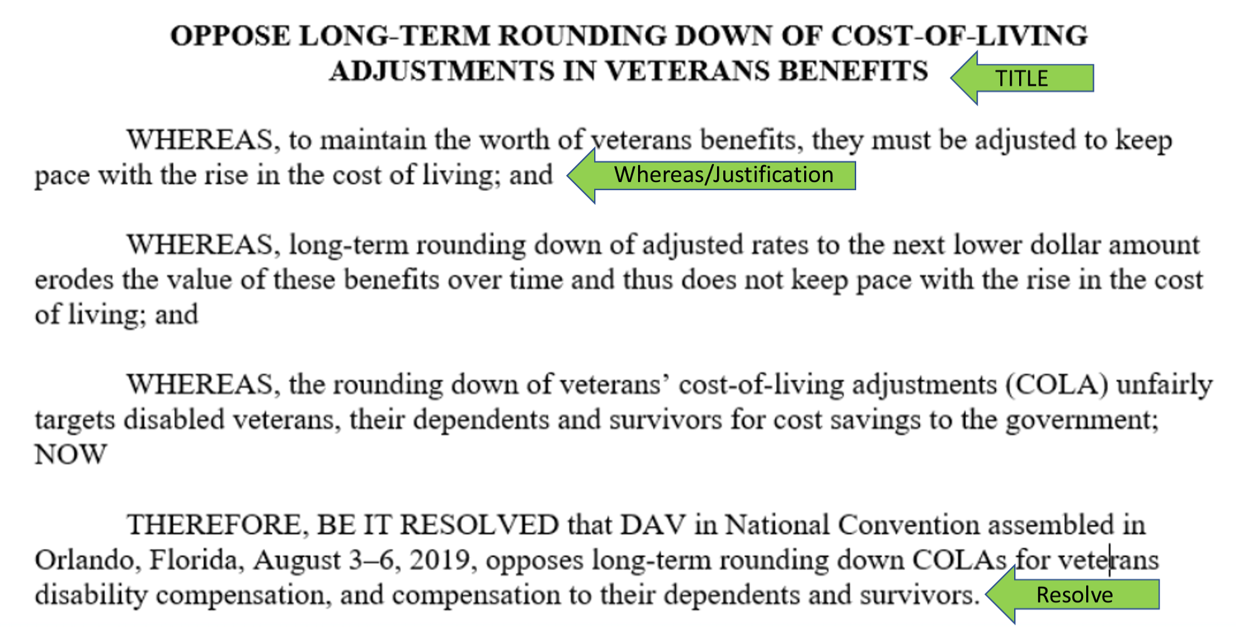
WRITING A RESOLUTION

Slide 12
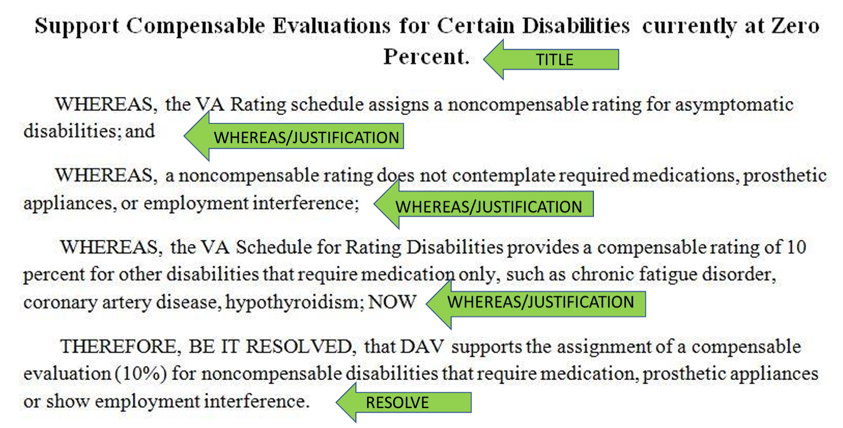
LET’S SEE ANOTHER EXAMPLE...

Slide 13
NOW LET’S PRACTICE...
The current VA FORM 21P-0847 states that the claimant for the purpose of processing the claim to completion has one year after the date of the death of the claimant, to request to be substituted as the claimant to continue adjudication of the deceased claimant's claim.
Can the resolution request for the date limitation be taken off or for more time than one year after the date of death?
NOW IT’S YOUR TURN!
What’s important to you:
Fort McClellan, Burn Pits, Toxic Exposure, Tinnitus, Herbicide, Hearing, Military Sexual Trauma (MST), Entrepreneurship, Women?

Slide 14
ACTION ITEMS & WRAP UP
ACTION ITEMS
Each Chapter should identify an individual (typically your BPTL) to work with the Legislative Committee to accomplish three things:
Gather raw resolution ideas from members and forward them to Legislative Committee
The Chapter Membership should approve support for selected current resolutions
Present the DAV Legislative Goals to U.S. Representative (select Chapters)
WRAP UP: YOU SHOULD NOW –
Understand the resolution process
Know the resources that are available to assist you in researching

Slide 15
IN PART TWO...
ACTIVITY
SPLIT UP INTO GROUPS
Those interested in gathering raw resolution ideas and starting to research
Those interested in selecting current resolutions to support

Slide 16
Questions

