Slide 2
LVAP Local Veterans Assistance Program
Department of Virginia 2023

Slide 3
DSD Chairman
PDC Cynthia Bailey

Slide 4
Department of Virginia LVAP Manager
Debbie Wood

Slide 5
DAV Mission Statement
We are dedicated to a single purpose:
Empowering veterans to lead high quality lives with respect and dignity. We accomplish this by making sure veterans and their families can access the full range of benefits available to them; fighting for the interests of America’s injured heroes on Capitol Hill; and educating the public about the great sacrifices and needs of veterans transitioning back to civilian life.

Slide 6
DAV Voluntary Service
Service is the cornerstone of DAV’s mission of empowering veterans to lead high-quality and fulfilled lives. DAV has several programs including the VA Community Development and Civic Engagement (CDCE), DAV Transportation Network, Local Veterans Assistance Program (LVAP), and the National Disabled Veterans Winter Sports Clinic (NDVWSC)
Our nation’s heroes at VA Medical Centers, nursing homes and clinics need volunteers to assist them. Veterans who are homebound or who need assistance with household chores or transportation need our help too.
DAV volunteers can assist veterans, their families and caregivers through any of our volunteer programs by sharing their time and talents to perform a wide range of duties.

Slide 7
What is LVAP?
The Local Veterans Assistance Program (LVAP) was established by DAV in 2007 in order to produce metrics on the amount of volunteer hours donated each year. In 2013, DAV began to reward those Departments and individuals who donated the most hours.
Since the inception of the program, thousands of volunteers have donated nearly 3 million hours to veterans residing in their local communities.
LVAP initiatives are managed by each DAV Department, and reports are sent to the national organization. Without the input of hours from each Chapter this program would not succeed.

Slide 8
Why is LVAP Important?
In addition to tracking hours for awards, the hours reported are utilized by Chapters, Departments and the National Organization to report on the number of volunteer hours donated when speaking to government leaders, civic groups, and to the media.
Our elected officials have a much better understanding of the amount of time committed to service by DAV when you can talk to them armed with facts and figures.
Each hour donated by DAV members can be converted into a dollar figure, also. Utilizing the U.S. Department of Labor average hourly wage guide, the conversion of thousands of hours suddenly takes on a different meaning – one that anyone can see the impact of.

Slide 9
Why is LVAP Important?
In Virginia, an Economic Impact Report is produced that is used when our Line Officers or Legislative Committee members communicate with elected officials or the media. For example: utilizing LVAP and Transportation hours during FY 2015 (July 2014 to June 2015) and the U.S. Department of Labor average hourly wage for June 2014, the following was reported:
LVAP hours: 187,923
Transportation: 28,959
Total: 216,822
X $24.95/hr. = $5,411,205.90 of free labor
This total, times the economic factor of 7, equals a very impressive $37,878,411.30 that benefited the economy in the Commonwealth of Virginia!
FY2015 shown as example. Current years are higher in LVAP hours and dollar amounts

Slide 10
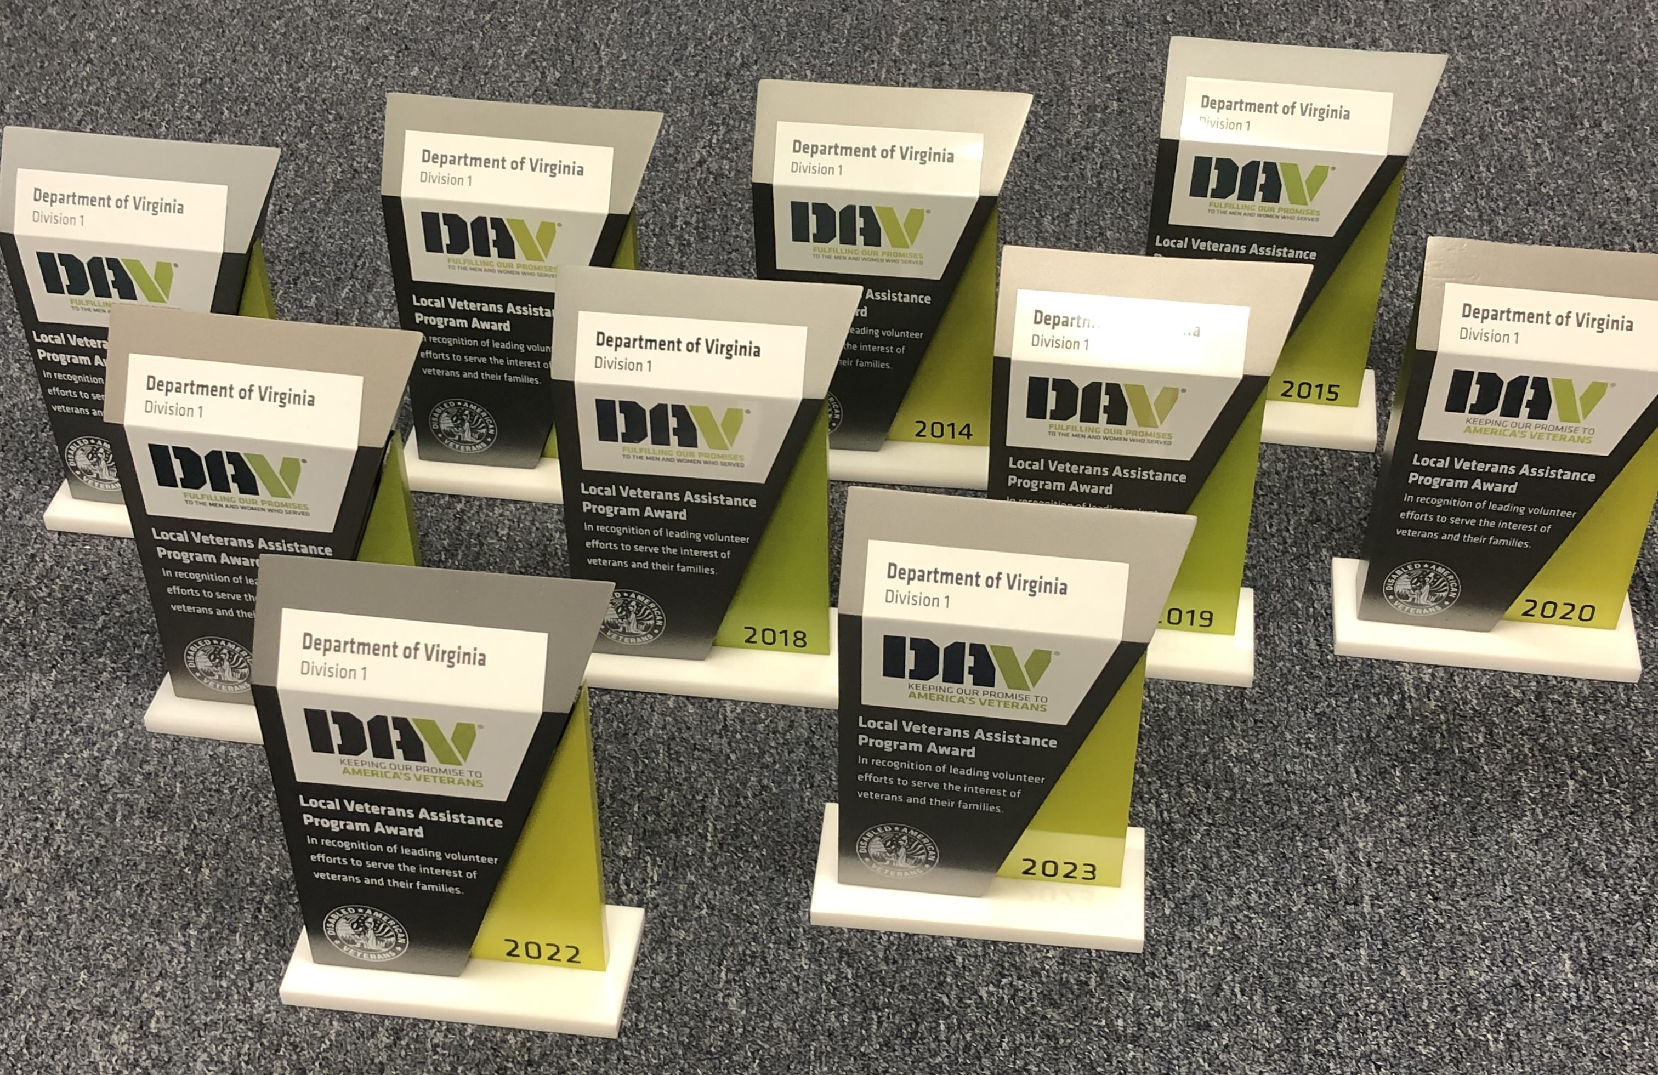
National Awards
DAV National Headquarters starting awarding
outstanding Departments in 2012.
Virginia won the Division 1 award in
2012, 2013, 2014, 2015, 2016, 2018, 2019, 2020, 2022 and 2023!

Slide 11
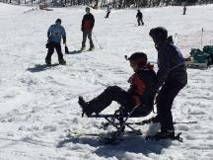
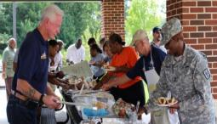
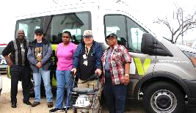
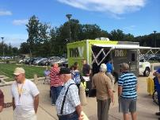
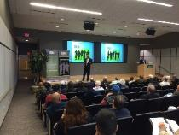
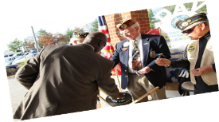
What Activities Count Toward LVAP Hours
Chapter and Department Service Officer work
(must be certified as a DSO/CSO)
DAV specific outreach efforts
Ex. DAV 5k Run, Walk and Roll, , NDVWSC,
Community Briefings on DAV programs
Fundraising efforts
Ex. Forget-Me-Knot Drives, Golden Corral, etc.
Direct assistance to veterans, surviving spouses, or families
Ex. Yard work, Home repairs, Respite care for caregivers, transportation, shopping with a veteran
Offering pro bono professional services, skill or trade services
Supporting activities for homeless veterans, such as stand-down's, etc.

Slide 12
Job Descriptions for LVAP Reporting
Chapter Service Officer - These are hours worked by an official DAV Chapter Service Officer. Hours reported as CSO without a certification from the DAV National Service and Legislative HQ will not be credited. These hours should be reported whether the CSO is working in a paid, or non-paid position.
DAV Outreach - These are any hours dedicated to the furtherance of DAV's Mission and/or programs. Examples include Seminars, Workshops, Training, Volunteer Driving Certification, Disaster Relief and thrift store activities. (Department and Chapter meetings that include a formalized seminar, workshop or training for DAV related programs may be reported as DAV Outreach. Meetings that do not include these sessions should not be reported.)
Department Service Officer - These are any hours worked by an official DAV Department Service Officer. Hours reported as DSO without a certification from the DAV National Service and Legislative HQ will not be credited. These hours should be reported whether the DSO is working in a paid, or non-paid position.
Fundraising - These are any hours performed for DAV Fundraising events. This should include hours for event planning, as well as day of event activities. Examples include Forget-Me-Not drives, sweepstakes, Golden Corral events, local 5k events, etc.

Slide 13
Job Descriptions for LVAP Reporting, cont.
Grassroots: Legislative - These are hours completed by a Benefits Protection Team Leader for the furtherance of DAV legislative efforts.
Homeless Stand Down - These are any hours completed for the planning and day of activities for a local Homeless Veterans Stand Down.
LVAP - Any hours completed for Department and/or Chapter initiatives that do not fit into a specific LVAP category.
Special Events - Any hours dedicated to a DAV or DAV Auxiliary event such as State Fairs, National Guard Mobilizations/Demobilizations, Memorial Day events, Veterans Day events etc. (Time spent in Department and Chapter meetings planning special events may be reported under Special Events. Meeting times that are not dedicated to event planning should not be reported.)
Veteran Assistance - Any hours dedicated to the direct assistance of veterans, spouses and families. Examples include Yard Work, Home Repairs, Grocery Shopping, Caregiver Respite, and Rides to medical appointments (using private vehicle).

Slide 14
Who Can Volunteer?
Chapter members
Unit members
Unit members also includes children of a military veteran relative (age up to 21) who may earn LVAP hours to qualify to apply for a DAV National Jesse Brown Memorial Scholarship award (minimum of 100 hours to qualify)
Based on the number of hours you volunteer, various awards are given by both the Department and the National DAV Organization

Slide 15
How to Report LVAP Hours
Each Chapter should designate one member as an LVAP Volunteer Coordinator to gather the hours each month for the members
Hours are noted on the approved Department form
Form is then emailed to the DAV Virginia LVAP Coordinator at Headquarters – davlvapva@gmail.com
Chapter Coordinator should keep a copy of each month’s form submitted

Slide 16
How to Report LVAP Hours
After completion of the form send it electronically to:
Debbie Wood
Virginia DAV LVAP Manager
davLVAPva@gmail.com
540-206-2575, ext. 3
Should the Chapter LVAP Coordinator need a copy of a Chapter report they can contact the LVAP Manager. Further information about LVAP is available on the DSC page of the Department Website:
http://www.virginiadav.org/department-service-commission

Slide 17
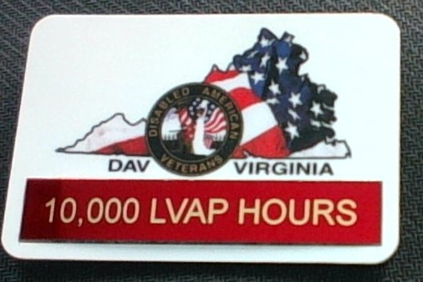
Virginia LVAP Awards
The Department Service Commission has established an award badge for those DAV and DAVA Virginia members who have accumulated a minimum of 5,000 hours of documented LVAP service.
Hours Bar Color
5,000 Blue
10,000 Red
15,000 Bronze
20,000 Silver
25,000 Gold

Slide 18
Resources
DAV publishes several booklets and handouts that cover the Volunteer Service Program, LVAP, as well as the DAV Brand Stylebook and DAV Language Guide.

Slide 19
LVAP Contacts
Virginia DAV LVAP Manager
Debbie Wood
davLVAPva@gmail.com
540-206-2575, ext. 3
DSD Chairman
Cynthia Bailey, PDC
davDSDva@gmail.com
757-286-8080

Slide 20
Department of Virginia Disabled American Veterans P.O. Box 7176 Roanoke, VA 24019-0147 540-206-2575 toll free: 866-706-5889 www.VirginiaDAV.org @DAVVirginia
© 2023 DAV-Department of Virginia. ALL RIGHTS RESERVED
No part of this work covered by the copyright herein may be reproduced or used in any form or by any means without permission from DAV-Department of Virginia

Slide 21
21

