Slide 1

Hampton VA Medical Center
Homeless Programs

Slide 2

Overview
Homeless Programs
HCHV HUD-VASH
Health Care for Homeless Veterans Housing and Urban Development –
Walk-in’s, Outreach, GPD, Contracts, VJO, Veteran Affairs Supportive Housing
HCRV, HCVES
HPACT
Homeless Patient Aligned Care Team

Slide 3

Who We Are And Who We Serve
Health Care for Homeless Veterans Program (HCHV)
Also known as “The Homeless Program” and “HPACT”, but officially, we are the HCHV program.
The HCHV program serves homeless Veterans.
Most VA Medical Center Homeless Programs are typically for veterans who are eligible for VHA (Veterans Health Administration) health care services.
However, Veterans who do not meet VHA eligibility criteria are linked to community resources as applicable.

Slide 4

Why We Serve
Homelessness is a serious public health issue: Research shows Veterans with a history of street homelessness are in physical conditions of peers 20 years older. The mortality rate of the homeless population is eight times higher than that of housed peers.
VA resources are targeted toward research findings: One-third self resolves, often with only the help of family or friends (diversion), one-third needs short term assistance – treatment, assistance connecting to benefits, employment help; the final one-third are chronically homeless, needing long-term help to maintain housing.
Annual PIT Count: The success of local VA Homeless Programs is largely gauged on the ability to reduce the number of homeless Veterans counted annually in shelters and places not meant for habitation.
This Photo by Unknown Author is licensed under CC BY-SA

Slide 5

What We Provide
Outreach to homeless Veterans in the community
Referrals to VA mental health care and primary care services
Referrals to substance abuse treatment
Referrals to employment assistance
Emergency referrals (food/shelter)
DD-214 requests
Referrals to transitional and permanent housing
Referrals to VBA Homeless Coordinator for VA service-connected compensation and non-service-connected pension claims
This Photo by Unknown Author is licensed under CC BY-SA-NC

Slide 6
Programs We Offer
Grant and Per Diem Program (GPD)- Transitional housing program that provides supportive services to literally homeless Veterans. These programs are operated by grants awarded to community agencies by the VA.
Contract Programs- Programs operated by contracts awarded to community agencies to provide emergency shelter and supportive services to literally homeless Veterans while they work on establishing resources and stability for permanent housing.
Veterans Justice Outreach/Health Care for Re-entry Veterans (HCRV)- Veterans Justice Outreach Specialists are responsible for direct outreach, assessment, linkage to resources, and brief case management for justice-involved Veterans in local courts, jails, and prisons, prior to and upon release from jail or prison as clinically indicated, and liaison with local justice system partners.
Homeless Veteran Community Employment Services (HVCES)- Employment program that provides a range of site-specific employment services, rather than being a discreet program.
Case Management Services- Offered to literally homeless Veterans, eligible for VHA healthcare services, who have been identified by HCHV staff to be unable to navigate community and homeless resources independently as required to obtain and maintain stable housing.
Homeless PACT clinic (HPACT)- Primary Care Clinic for Veterans who are homeless and/or participating in a VA Homeless Program.

Slide 7
Grant and Per Diem Program (GPD)
GPD Programs are funded by the VA to eligible non-profit organizations, state, and local governments who can provide transitional housing and supportive services to homeless Veterans (grant funds are posted on the federal registry as a “NOFA” – Notice of Funding Availability).
GPD Programs have 3 universal goals for Veterans: (1) Achieve residential stability; (2) Increase their skill level and/or income; and (3) Obtain greater self-determination.
Referrals generally are originated from the local coordinated entry meetings; targeting those Veterans who are literally and/or imminently at-risk of homelessness.
Vacancies are reported to local COC’s through Homeless Management Information System (HMIS) and during service coordination meetings.
Unlike other VA services, GPD provides transitional housing to Veterans who may not be eligible for VHA or VBA. Veterans are eligible if they served, regardless of length of time, in the active military, naval, or air service, and were discharged or released from conditions other than Dishonorable. Anyone with a Bad Conduct discharge from a general court-martial are ineligible, anyone with a Bad Conduct discharge from a special court-martial is eligible.
Our local GPD Program is run by the Judeo-Christian Outreach Center (JCOC) in Virginia Beach. They have 16 beds (12 single males and 4 single females). Veterans work with a case manager on their permanent housing goals; generally, they are discharged within 6-9 months depending on barriers and vulnerabilities but have up to 1 year to stay in the program.

Slide 8
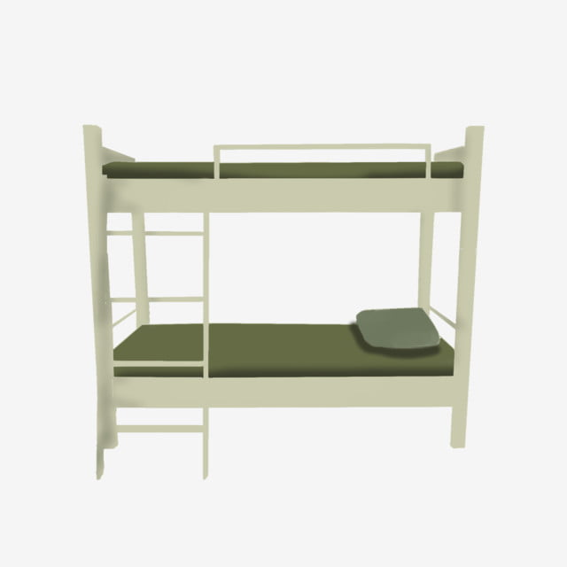
Contract Programs
HCHV CERS – HCHV Contract Emergency Rehabilitative Shelter Programs: Contracts awarded via competitive process to local non-profits to provide rehabilitative care and emergency or bridge housing for literally homeless Veterans. Veterans must be capable of managing ADL's independently and have identified Housing or Rehab goals. There is currently no funding for new contract programs.
The Salvation Army Hope Center Emergency Men's Shelter VA Contract Program: Up to six beds of barracks-style shelter within operating shelter and day program in Norfolk; allowed to stay inside during daytime hours. Meals, case management, and basic transportation are provided. Average length of stay is one week up to three months.
LINK Mental Health Rehabilitative Shelter Program: Up to seven male beds of transitional rehabilitative shelter in a home-like setting (at two different locations in Oyster Point/Denbigh area of Newport News). Chronically homeless Veterans, Veterans with a history of mental health or substance abuse issues (must be stable at admission), and homeless Veterans recovering from acute medical conditions/procedures are highest priority. Focus is on Recovery goals, practicing independent living skills, and obtaining housing. Average stay is one to six months.

Slide 9

Veterans Justice Outreach (VJO)
“Veterans Justice Outreach (VJO) initiative is to avoid the unnecessary criminalization of mental illness and extended incarceration among Veterans by ensuring that eligible Veterans in contact with the criminal justice system have access to (a) Veterans Health Administration (VHA) mental health and substance abuse services with appropriate, and (b) Other VA services and benefits as appropriate.” Source: Department of Veterans Affairs, April 30, 2009. Information Letter from Under Secretary for Health.
Typical Functions: point of contact at the Veterans Affairs Medical Center (VAMC) for the criminal justice community (e.g., courts and legal system, law enforcement, and jails); assessment of Veteran healthcare needs and identification of VA and/or community-based services; case management; and case coordination services.
The VJO Specialist is a healthcare provider, typically a Social Worker, who can serve in a reporting, referral, and educational context — NOT as an attorney or legal advocate.
This Photo by Unknown Author is licensed under CC BY-SA

Slide 10

Health Care for Re-entry Veterans (HCRV)
Most Veterans who are in jail or prison will eventually reenter the community. VA’s HCRV program is designed to promote success and prevent homelessness among Veterans returning home after incarceration.
HCRV services include outreach, pre-release assessment services for incarcerated Veterans (in State and Federal prisons), referral and linkage to medical, mental health, social services, legal resources, and employment services, upon release.
HCRV Specialists also perform short term case management, on-going outreach and crisis intervention, care coordination, serve as liaison between the Department of Correction and the Department of Veterans Affairs, serve on reentry council throughout the VA service area, facilitation of groups, perform presentation regarding VA services, resources, and care, and interact with probation/ parole officers, attorneys, and other correctional officials.

Slide 11

Homeless Veteran Community Employment Services
The Homeless Veteran Community Employment Services program (HCVES) provides employment services and resources to Veterans participating in Veterans Health Administration (VHA) homeless programs in order to increase access to permanent housing and improve housing stability. This is accomplished both through the provision of direct services and by providing a bridge to employment opportunities and resources in the local community.
Veterans assessed for VHA Homeless Program services are queried regarding interest in receiving employment services regardless of the Veteran’s disability status. Veterans identified as interested in receiving assistance with employment will have access to employment services that will support them in overcoming barriers in returning to work, including the following: a poor work history, lack of transportation and appropriate clothing, history of justice involvement, and co-occurring substance use and/or mental health issues. Based on individual need, employment assistance will be provided directly.

Slide 12

Homeless Veteran Community Employment Services cont’d
The Community Employment Coordinator (CEC) helps improve employment outcomes for homeless Veterans through the development of community-based employment opportunities and partnerships with both VA and non-VA employment programs. This includes, but is not limited to, collaboration with VHA Vocational Rehabilitation (formerly Therapeutic and Supported Employment Services (TSES)), Veterans Benefits Administration’s (VBA) Veteran Readiness and Employment (VR&E), Department of Labor (DOL) Veterans Employment and Training Services (VETS), Homeless Veterans Reintegration Program (HVRP), and state and local agencies.
The Employment Specialists assess the vocational needs of homeless Veterans and provide direct services and referrals to include, but not be limited to, access to job listings, resume preparation, benefits counseling, job negotiations regarding reasonable accommodations, assistance with completion of job applications, coordination and transportation to interviews, interview skills training, job development, job placement, and ongoing support for job retention.

Slide 13
Homeless Patient Aligned Care Team (HPACT)
What is HPACT?
A one-stop-shop, comprehensive, easily accessible, primary care medical team for Veterans who are homeless and/or involved in a VA Homeless Program.
Provides medical care and referrals to mental health and other services as needed.
Not intended for Veterans who have an established primary care provider.
HPACT Staff:
Kimberley Gipson, MD
Richard (Trevor) Kay, RN
Erma Jackson, MSA
To refer a patient or for questions, please feel free to call 757-722-9961, ext. 3349.

Slide 14
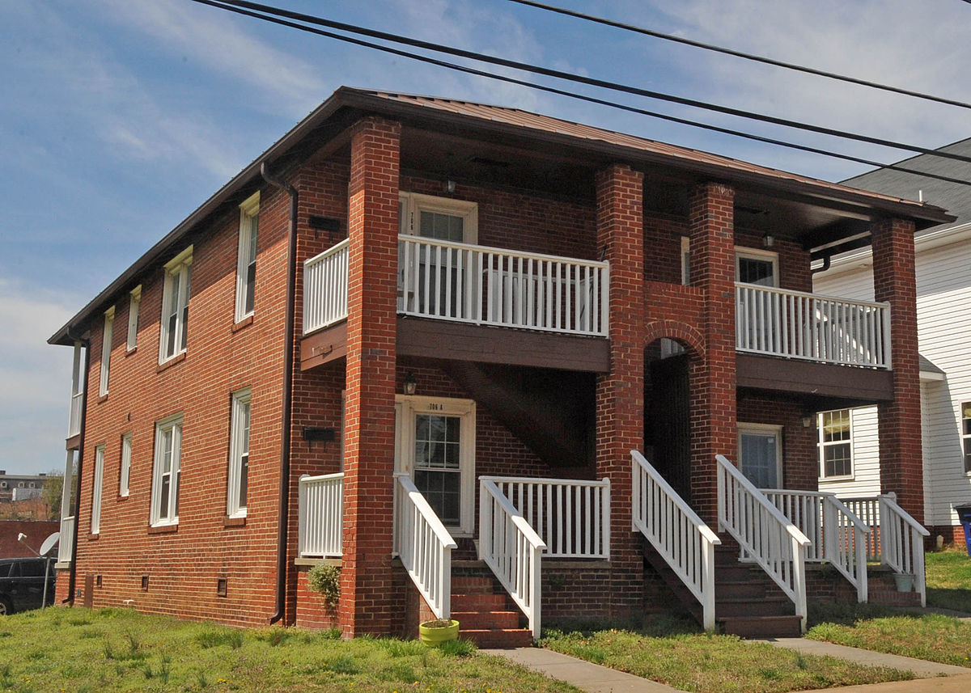
VA Housing Programs
Supportive Services for Veteran Families (SSVF)- A housing program for very low-income Veterans that provides time-limited case management, temporary financial assistance, and supportive services to rapidly re-house Veterans and their families who are experiencing literal homelessness. These services are provided by community agencies funded by VA grants. (HRCAP, STOP Organization, VBCDC, ForKids) May also provide limited homeless prevention services.
Department of Housing and Urban Development-Veterans Affairs Supportive Housing (HUD-VASH)- A collaborative program between HUD and VA that combines HUD housing vouchers with VA supportive services to help Veterans who are experiencing homelessness and their families find and sustain permanent housing. Case management is a required component of this program.
This Photo by Unknown Author is licensed under CC BY-SA

Slide 15
Eligibility Criteria
For GPD, Contract Programs, Case Management, HUD-VASH, and SSVF rapid rehousing programs, Veterans must be literally homeless. Literal homelessness is defined by HUD, not the VA.
  Literal homelessness means that (1) Individual or family who lacks a fixed, regular, and adequate nighttime residence, meaning: (i) Has a primary nighttime residence that is a public or private place not meant for human habitation; (ii) Is living in a publicly or privately operated shelter designated to provide temporary living arrangements (including congregate shelters, transitional housing, and hotels and motels paid for by charitable organizations or by federal, state and local government programs); or (iii) Is exiting an institution where (s)he has resided for 90 days or less and who resided in an emergency shelter or place not meant for human habitation immediately before entering that institution or;
  Any individual or family who: (i) Is fleeing, or is attempting to flee, domestic violence; (ii) Has no other residence; and (iii) Lacks the resources or support networks to obtain other permanent housing.
For Contract Programs and Case Management, Veterans must be literally homeless and eligible for VHA Healthcare services.
For GPD, SSVF, and HUD-VASH, Veterans must be literally homeless and can have an Honorable, General, OTH, or Bad Conduct discharge with Special Court Martial from the military. NG/Reserves are ineligible unless activated for combat/federal emergency greater than 90 days.
Program eligibility is also based on income.

Slide 16
How to Get Connected to Services
As an office walk-in to the Homeless/HPACT clinic
  M 8:30-11am, 1-2pm
  T-F 8:30-11am, 1-3pm
Outreach in the community
Referred from a community provider
Contact the Hampton VAMC Homeless Program office at (757) 722-9961 ext. 4417 and request to speak to a social worker
Call the National Call Center for Homeless Veterans at 1-877-421-3838
Call the Regional Housing Crisis Hotline at 757-587-4202
For Veterans who have verified literal homelessness, a housing assessment will be completed. The housing assessment will be presented at a Coordinated Entry meeting (community housing committee) that will then make a housing intervention recommendation based on eligibility, availability, and vulnerability. If the Veteran is referred to an agency for housing assistance, the agency will then contact them to begin the process.

Slide 17

Hotlines
The National Call Center for Homeless Veterans (NCCHV) is a VA hotline Veterans can call from anywhere in the United States and receive a response from their local VA Homeless Program within one business day. The NCCHV hotline is the best resource to call if you have questions about VA Medical Center Services for Homeless Veterans and VA eligibility benefits. Veterans can also chat with NCCHV hotline staff online or can even text NCCHV. If calling the NCCHV Crisis Hotline from the Hampton Roads area, callers will also be directed to call the Regional Housing Crisis Hotline to be connected to local resources (1-877-421-3838).
The Housing Crisis Hotline is a local hotline that keeps track
of all resources in the area and can assess which resources are best for each
person or family. This can eliminate the need to make dozens of calls to
agencies that may not be able to assist in a crisis. Most local shelters,
resources, and even agencies that serve mostly Veterans MUST get referrals
from the Regional Housing Crisis Hotline before assisting, so it’s best to call
the Regional Housing Crisis Hotline if looking for local resources (757-587-4202).

Slide 18
How You Can Help
Encourage the Veteran to call the Housing Crisis Hotline- If the Veteran is experiencing a housing or homelessness crisis, this is the best way for them to get connected to potential assistance. Please encourage them to be patient. Nothing happens immediately.
When documenting a Veteran’s homelessness, be as specific as possible (couch surfing vs. shelter vs. hotel/etc.) Specific documentation is essential to providing the best intervention for the Veteran.
Provide them with resources:
  www.virginiahousingsearch.com
  Call 211 for up-to-date food assistance/food bank info
  Local churches in their area who may provide assistance
  Virginia Veteran and Family Support 1-877-285-1299
  Department of Veterans Services (804) 786-0286
  Mission United 757-858-7777
  Local Vets Services Organizations (DAV, American Legion, VFW, AmVets, etc)
  For foreclosure prevention, contact VA’s Home Loan Center at (877) 827-3702
  Energy Share-contact local SSVF agencies (HRCAP, STOP Organization, VBCDC, ForKids)
  Legal Aid 1-866-534-5243

Slide 19

Tips to Remember
No one can self-refer to HUD-VASH. 10 times out of 10, HUD-VASH staff will redirect a Veteran back to HCHV for a homeless assessment.
Unfortunately, we don’t always have an immediate solution for every Veteran’s situation.
Most of the resources we provide are based on what is available in the community at that time.
Resources are based on both eligibility criteria (income, etc.) and availability.
Most, if not all, resources are also based on income limits set by HUD federal guidelines.
The housing process takes time.

Slide 20



HUD-VASH
Housing and Urban Development - Veterans Affairs Supportive Housing Program (HUD-VASH)
HUD-VASH is a collaborative program between the Department of HUD and the Department of VA. It emphasizes a strategy to house chronically homeless Veterans and their families, utilizing HUD housing vouchers and combining them with VA supportive services.
These Veterans are considered to be the most vulnerable who may not be able to maintain housing without long term support.
Veteran participants in the HUD-VASH program must have an Honorable, General, OTH, or Bad Conduct discharge with Special Court Martial from the military. They must meet the definition of homelessness, be within the income limitations, and be agreeable to case management services.
+

Slide 21



HUD-VASH continued
Housing and Urban Development - Veterans Affairs Supportive Housing Program (HUD-VASH)
The HUD-VASH program was developed to support the national goal of ending homelessness for the hardest-to-serve individuals. These Veterans often need a broad range of support to establish and maintain themselves in the community.
HUD-VASH services not only address housing issues but also mental health, substance abuse, and physical health needs, helping to decrease Veterans returning to homelessness. Multidisciplinary staff work together on behalf of Veterans in the program.
Case management is a required component of this program and assists with the support to ensure that needed services are continued.

Slide 22


HUD-VASH continued
Housing and Urban Development - Veterans Affairs Supportive Housing Program (HUD-VASH)
Each Veteran in the program is assigned a Social Work Case Manager to support them on their journey in the program.
Case Managers also work with Veterans to develop a treatment plan to identify goals, improve their quality of life, and help maintain their permanent housing.
Case Managers work with Veterans to identify issues, link services, coordinate care, and provide supportive services for the Veteran.

Slide 23

Wrap-Up
HCHV
HUD-VASH
H-PACT
Veteran
Working together toward the same goals of supporting Veterans to be successful and decreasing homelessness.

Slide 24
Program Brochures and Information

Slide 25

QUESTIONS???
For staff who may have any questions regarding HCHV/HPACT, feel free to email vhahamhpact@va.gov.
For staff who may have any questions regarding HUD-VASH, feel free to email
doris.cruea@va.gov.
This Photo by Unknown Author is licensed under CC BY-NC
This Photo by Unknown Author is licensed under CC BY-NC

