Slide 2
Chapter Financial Management
Department of Virginia 2022

Slide 3
Instructor
Francis Mitchell
Department Senior Vice Commander

Slide 4
DAV Mission Statement
DAV’s mission defines what we do, why and how we do it, and how we change lives.
We are dedicated to a single purpose:
“Empowering veterans to lead high quality lives with respect and dignity”
We accomplish this by making sure veterans and their families can access the full range of benefits available to them; fighting for the interests of America’s injured heroes on Capital Hill; and educating the public about the great sacrifices and needs of veterans transitioning back to civilian life.

Slide 5
Chapter Financial Management
DAV National
Constitution and Bylaws
Chapter
Constitution and Bylaws
How we conduct our financial affairs is embedded in these two documents
DAV National
Constitution and Bylaws
Chapter
Constitution and Bylaws
Big Picture
Structure and Practice

Slide 6
Chapter Financial Management
DAV National
Constitution and Bylaws
DAV
KEEPING OUR PROMISE TO
AMERICA’S VETERANS
National Constitution,Bylaws, NEC Regulations & Board of Directors
Information
National Convention
Tampa, Florida
July 31 - August 3, 2021
Each chapter shall keep a complete financial record of all monies received and expended.
Section 9.3 – Financial Records, Reports
All other assets (except for minimal amounts of cash on hand) must be safeguarded or deposited in a manner appropriate to the asset and consistent with sound business practice.

Slide 7
Chapter Financial Management
Chapter
Constitution and Bylaws
DAV
KEEPING OUR PROMISE TO
AMERICA’S VETERANS
National Constitution,Bylaws, NEC Regulations & Board of Directors
Information
National Convention
Tampa, Florida
July 31 - August 3, 2021
Structure and Practice
Board of Directors Composition
Budget & Finance Committees
Guidance
Treasurer Responsibilities
Audit Committee

Slide 8
Chapter Financial Management
Fundraisers
Banking
Savings Accounts
Annual Financial Reports
Credit Unions
Expense Vouchers
Emergency Relief
Quarterly Reports
Golden Corral
AFR
IRS 990
Checking Accounts
Letters of Receipt
Membership Distribution
Fundraiser Applications
Certificate of Deposit
Bank Reconciliations

Slide 9
National Constitution and Bylaws
National Executive Committee Regulation 5
Income from Fundraising is the hallmark of our efforts…
Income from Forget-Me-Not drives shall be used solely for service to disabled veterans, their dependents and survivors and for no other purpose.

Slide 10
National Constitution and Bylaws
National Executive Committee Regulation 5
Income from Fundraising is the hallmark of our efforts…
Income from approved Department or Chapter fundraising activities shall be used to support programs and activities sponsored by DAV, its subordinate units or other entities, as long as such programs and activities provide a direct and substantial benefit to disabled veterans, their dependents and survivors.

Slide 11
Forget-Me-Not Drives
Paragraph 5: Any chapter, and any DAV Auxiliary unit, with its chapter’s prior consent, may conduct an annual Forget-Me-Not Drive, involving solely the offering of Forget-Me-Not flowers purchased through National Headquarters, where there is no paid promoter involved, unless prior approval is expressly required by this Section. Each chapter or DAV Auxiliary unit shall advise the state department of the dates planned, which shall not exceed seven total days throughout the membership year.
Paragraph 7: No member shall solicit funds or offer for sale any form or kind of merchandise or service as a disabled veteran, or in the name of the Organization, or while wearing any portion of the DAV uniform, except with the approval of the chapter(s) of the particular chapter town in which he or she is operating, and of the state department.

Slide 12
DAV Fundraisers
Paragraph 8: Notwithstanding anything to the contrary, any department, chapter or DAV Auxiliary desiring to engage in fundraising projects involving, directly or indirectly, contracts of any nature shall be required to obtain prior approval from their department and the National Executive Committee.
Paragraph 10: All net income raised from fundraising projects shall be required to be devoted, within a reasonable time, to the cause or program for which it was intended.

Slide 13
DAV Fundraisers
National Bylaws Article 15 – Sources of Income
Section 15.4 – Subordinate Units Generally
No local unit of the DAV Auxiliary shall conduct any fundraising project:
Without the prior approval of the Chapter with which it is affiliated
Without approval of the DAV Department

Slide 14
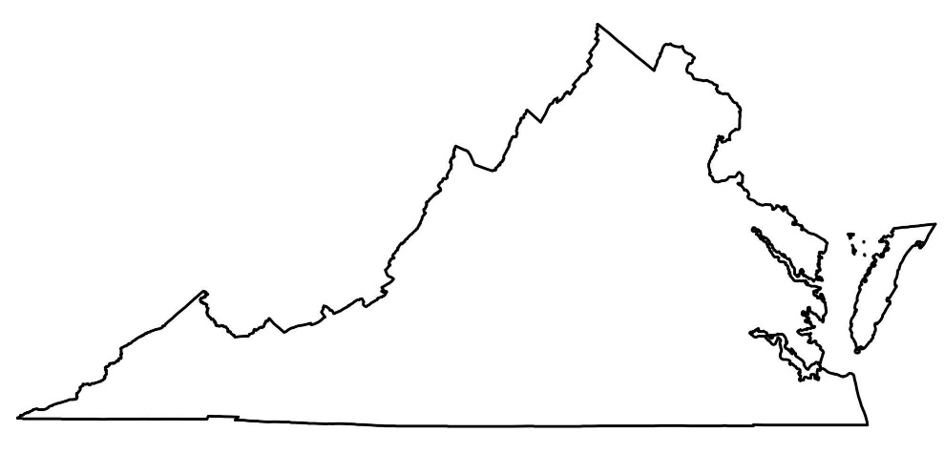
DAV Fundraising – Outside your Chapter area
Fairfax
Richmond
Eastern
Shore
Permission
Roanoke
Yorktown
Bristol
Danville
Chesapeake
Va Beach
Any local Chapter, Unit or other subordinate unit of the DAV Auxiliary, that desires a fundraising drive or activity in the territory of more than one Chapter, before asking for the required approval, shall give written notice of intention to ask such approval, with reasonably detailed info about the proposed drive or activity, to all Chapters concerned NLT two weeks before seeking approval, and all such chapters shall have the right to protest, promptly to the Department.
.
NLT 2 weeks prior to each fundraising activity you must give notice to the Dept. SCV, on the form provided by the Department, and written approval of other Chapters if outside your area!

Slide 15
Software – Choosing What’s best
Excel is a helpful and powerful program for data analysis
and documentation.
It is a spreadsheet program, which contains several columns and rows, where each intersection of a column and a row is a “cell.”
Each cell contains one point of data or one piece of information.
Data entry & Management
Accounting & Financial Analysis
Charting and graphing
Programming
Time & Task management
Financial modeling
Customer relationship management (CRM)
Almost anything that needs to be organized!
Thrift Store Chapter
Quarterly Report
EXCEL is the only format
the Department accepts

Slide 16
Software Comparison
QuickBooks is designed specifically for small businesses.
Although Quicken does include a handful of business finance capabilities within the Home & Business version of their software, these features are largely meant to accommodate professionals with side businesses or rental properties.
QuickBooks (regardless of the version), is first and foremost a small business accounting platform, with all of the functionality required for a business’s (Chapters) bookkeeping, accounting, and general financial management

Slide 17
Chapter Financial Management
Each Chapter Shall Have an Audit Committee
At least
3 Chapter members
3 Coincides with signing AFR
The Audit Committee reports to the Commander
Officers who may not serve on the Audit Committee…
Chapter
Commander
Senior Vice Commander
Adjutant
Treasurer
Finance
Chair

Slide 18
Chapter Audit Committee
Each Chapter Shall Have an Audit Committee
At least
3 members of Chapter
Shall
conduct an annual audit
Audit
$25,000
and-if
ASSETS & LIABILITIES
National Organization
CHAPTER EXPENSES
CHAPTER
AFR
Not from
membership
BANK STATEMENTS
Department of Virginia
AFR
AUDIT PERFORMED
TREASURER
Audit Committee Signs

Slide 19
Accounting Practices
Department of Virginia
Agreed-upon Procedures for
Independent CPA Reports

Slide 20
Treasurer Shall
Ensure the Monthly Recap (file) folder of working documents provides:
CEC meeting minutes
General membership meeting minutes
Bank statements
A financial report (summary of checking and savings accounts)
List of itemized income receipts & expenses
Payment / reimbursement vouchers

Slide 21
Audit Committees
Ensure each member of the Audit Committee:
Is NOT a line Officer IAW DAV National C&B:
Commander
Sr. Vice Commander
Adjutant
Treasurer
Finance Committee Chair
HAS initialed and dated a cover sheet (evidence that the monthly supporting working papers contained executive meeting minutes, general memberships meeting minutes, the financial report, bank statements, and vouchers).

Slide 22
Chapter Financial Management
Evidenced by his signature on the financial report (which should include all itemized income and expenses)
Are reviewed by an officer other than the Treasurer as evidenced by their initials on the financial report.
Agree with bank statements provided.
Evidenced by his signature on the financial report (which should include all itemized income and expenses
Are reviewed by an Officer other than the Treasurer as evidencd by their initials on the financial report
Agree with the bank statements provided

Slide 23
Independent CPA Report
Ensure monthly financial reports are prepared by the Treasurer
Evidenced by his signature on the financial report (which should include all itemized income and expenses
Are reviewed by an Officer other than the Treasurer as evidenced by their initials on the financial report
Agree with the bank statements provided
Ensure all expenses
support Chapter operations or support to the veteran

Slide 24
Independent CPA Report
Ensure Quarterly financial report:
Breaks out ALL spending to match the approved budget
Ensure monthly working papers:
Such as vouchers and cancelled checks, agree with monthly bank statements and monthly general ledgers of profit and loss accounts, if provided.

Slide 25
Independent CPA Report
Ensure checks are:
Signed by two of three — Commander, Adjutant, and Treasurer. Supported by vouchers for every expense
Ensure ALL vouchers are:
Authorized (i.e. signed) by at least two out of three of the Commander, Adjutant, and Treasurer.
Supported by receipts, invoices, or other support (e.g. approval in meeting minutes).

Slide 26
Independent CPA Report
Ensure Bank Deposits
Have a detailed record of whom funds were received from and for what purpose
Identify cash deposits with annotation on deposit receipts
Bank Statements
Ensure transactions on monthly bank statements and monthly general ledgers of profit and loss accounts (if provided), are supported by monthly supporting working papers, such as vouchers and cancelled checks

Slide 27
Independent CPA Report
Ensure Emergency Relief / Homelessness expenses are limited to the maximum amount allowed in Chapter C&B
Emergency Relief Grant capped at $500.00
Homelessness Grant capped at $500
Expenses cannot be combined

Slide 28
Areas To Watch
CEC Minutes don’t reflect recommended expenses to the Body
Commanders discretionary fund - not allowed
Emergency Relief payments exceeding the Chapter C&B approved amount
Expense Vouchers for Per Diem, Meals & Incidentals and mileage
IF you are following GSA rules — adhere to them
IF your C&B has a set if rules — don’t deviate
Use two-person control (TPC) philosophy — when collecting & accounting for funds…
Do not hold peoples “Cash or Checks”
HAVE a receipt book on hand
Ensure your copy of deposit slips can show where funds came from — write on the slip, “deposit from XXX”. The CPA/Auditor needs to see the paper trail
The proper way for recording funds in your QuickBooks/Excel, other system
Overpayment to member
Refund of purchase by the chapter
Income
Donation

Slide 29
Areas To Watch
Board of Directors Meeting following elections
Donations to other 501(c) organizations
Constitution and Bylaws don’t identify limits on spending
No budget or budget doesn’t reflect total income forecasted
Donations to other Chapters
IMPORTANT that the receiving Chapter send a letter of receipt—to be attached to paying chapters AFR
Quarterly Reports showing excessive spending
“Show me your checkbook and I’ll show you your mistakes”
Writing checks for cash
Holding checks and not immediately depositing
Transferring funds between accounts without the membership approval

Slide 30
Questions

Slide 31
Department of Virginia Disabled American Veterans P.O. Box 7176 Roanoke, VA 24019-0147 540-206-2575 toll free: 866-706-5889 www.VirginiaDAV.org @DAVVirginia
© 2022 DAV-Department of Virginia. ALL RIGHTS RESERVED
No part of this work covered by the copyright herein may be reproduced or used in any form or by any means without permission from DAV-Department of Virginia

Slide 32
Department of Virginia

