Slide 2
Chapter Elections

Slide 3
Instructor
James Smith Jr
Senior Vice Commander
Department of Virginia

Slide 4
Co-Instructor/ Advisor
John C. Simmons
Past Department Commander
Department of Virginia

Slide 5
Purpose
To provide guidance for conducting Chapter Elections
Governing regulations:
National and Department Constitution and Bylaws (C&B)
Department of Virginia C&B
Chapter C&B
Official Ritual of the Disabled American Veterans
Incorporated Chapters
Preparation
Election of Officers
Installation of Elected Officers
Appointment and Installation of Appointed Officers and Committees

Slide 6
Governing Regulations
National Constitution and Bylaws, Article 9, Sec. 9.2, Para 1:
Each chapter shall elect annually a Chapter Commander, a Senior Vice Commander, and one or more Junior Vice Commanders, and may elect or appoint an Adjutant and Treasurer. The Chapter may elect or appoint such other officers as necessary to operate the Chapter.
Elect and appointed officers must be installed within 30 days.
Neither the Commander nor any Vice Commander may simultaneously serve as the Adjutant or Treasurer.
Elections shall be in-person voting.
Department of Virginia C&B, Article 1, Sec1-4, Para 3 (d):
“Chapter Officers shall be elected and installed prior to the convening of the Department Annual Convention,” (held in June of each year).

Slide 7
Governing Regulations
Chapter Constitution and Bylaws
Each Chapter C&B should include a section dealing with the election and appointment of officers, installation, duties, reporting responsibilities, and officer succession (routine and emergency).
Official Ritual of the Disabled American Veterans
Contains Chapter meeting order of business, and includes the installation ceremony.
Board of Directors for Incorporated (Inc.) Chapters
The Virginia State Corporation Commission requires incorporated entities to have at least one board meeting annually and to report changes to officers and registered agents, as occurring. New Officers often require electing new corporate board members. Do not overlook this requirement.

Slide 8
Preparing for the Election
Notify members
Elections shall be held annually. Include the month in your Chapter C&B.
Send a notification of the upcoming election via the normal means of notifying Chapter members at least 5 days in advance, even though in the C&B.
Elections shall be held at a regularly scheduled general business meeting.
Elect a Nominating Committee
The Nominating Committee should be elected or appointed and approved by the body, at a General Business Meeting, at least a month prior to the election. The Nominating Committee should meet immediately to develop a candidate questionnaire and plans for interviews. Appoint the Tellers at this meeting.

Slide 9
Preparing for the Election
Invite an Officer to officiate
The invitation should be extended a month or two prior to the election, especially if you want a Department Officer to officiate the ceremony.
The retiring Commander, a State or National Officer, or a Past Chapter, Department or National Commander may conduct the election and installation of officers.
Gather materials (Election guide, Officer Installation guide, Chapter C&B, Chapter roster, timer, ballots, pencils/pens, tally sheets, etc.).
Photographs. Identify someone to take photos.
Review the procedures and duties, with current line officers, the Sergeant at Arms, Officer of the Day, Tellers and anyone else involved in the election and installation process.

Slide 10
Election Day
Sergeant at Arms
Ensure eligibility and accurate count of the members present to vote.
Check each person entering the meeting place against the most current Chapter roster. Each voter must be in good standing - - no disciplinary action pending and no indebtedness to the Chapter, Department or National.
Report the number of eligible voters to the Officiating Officer, when asked.
Visitors. Recommend that only visitors from the Department or another Chapter attending to observe the process, be allowed in the room during the election process. Other visitors may be invited into the room for the installation of officers.
Meeting facility layout. Enough space for a swearing-in formation, and a desk for the Tellers to work.
Start the meeting on time!

Slide 11
Election Process
Open the meeting with the routine DAV Ritual (Call to Order, Pledge, Prayer, Roll Call of the Officers, Quorum must be established, Introduce Visitors, Recognition of POW/MIA’s and Mission Statement).
Suspend routine business, for the purpose of the election.
Introduce the Officiating Officer, and request a motion from the floor to allow the Officiating Officer to conduct the election.(And installation?)
Commander: Present the gavel to the Officiating Officer.
Officiating Officer begins the ELECTION:
Order the Sergeant at Arms to report the number eligible voters present.
Order the Adjutant to enter the number of eligible voters in the minutes.
Introduce the TELLERs, and ask if they understand their duties?
Announce, “All positions are vacant. The floor is open for the election of officers.”

Slide 12
Election Process
Officiating Officer
Order the Nominating Committee Chair to present the written report.
Ask for a motion from the floor to dismiss the Nominating Committee with appreciation for a job well done.
Starting with the most JUNIOR elective position; Announce the Nominating Committee’s candidate(s) for that position only.
Ask THREE times: “Are there any further nominations?” (Accept nominations from the floor, if any.) If no further nominations, announce, “Nominations are closed.”
Ask the nominee(s): “Comrade(s), you have been nominated for the position of (_______). Do you accept the nomination, and will you execute the responsibilities of the position if elected? Nominees respond, individually.
IF only ONE person is nominated for the position; Order the Adjutant to cast one unanimous ballot for the nominee.
Announce and congratulate the ONE candidate as the winner.

Slide 13
Election Process
Officiating Officer: IF TWO or more members are nominated for the position;
Announce the names (from the Committee Report and the floor), and ask THREE times: “Are there any further nominations?” Hearing none, announce, “Nominations are closed.”
Ask each nominee: “Comrade, you have been nominated for the position of (_______). Do you accept the nomination, and will you execute the responsibilities of the position if elected? Nominees response individually.
Order the Sergeant at Arms to escort the candidates from the room.
Ask, “Does anyone have anything to say, pro or con, about the
candidates? Limit your comments to 3 minutes.”
Order the TELLERS to provide 1 blank ballot to each eligible voter.
State the position and name of each candidate, and direct the members to mark, or write the name of their choice, on the ballot.

Slide 14
Election Process
Officiating Officer
Allow 2-3 minutes for members to mark the ballot. Members shall vote for only 1 candidate, or abstain by writing “abstain” on the ballot. Members shall not refuse to return the ballot.
Order the TELLERS to collect and count the ballots.
TELLERS
Provide one ballot to each eligible voter. The total number of ballots provided must equal the total number of eligible voters present, as reported by the Sergeant at Arms. When ordered, collect the ballots
Provide a written “Teller’s Report” to the Officiating Officer. The report will contain the position/office, total eligible voters, total votes cast, each candidate’s name and votes received, and total abstentions. The ballots shall be retained by the Chapter until the next election cycle, or until reasonably sure there will be no challenges to the outcome.

Slide 15
Election Process
Officiating Officer
Order the Sergeant at Arms to escort the candidates back into the room. Candidates return to their respective seat.
Announce and congratulate the winner.
Continue on with the next SENIOR position (up the line), and repeat the process until all elective positions are filled. (The Commander is the last position voted.)
Ask for a motion from the floor to dismiss the Tellers with appreciation for a job well done.
Dismiss the Tellers.
Installation of the Elected Officers may immediately follow the election or be held another day.

Slide 16
Installation of Officers
Officiating Officer
Order the Officer of the Day (OOD) to escort the newly elected officers to stand in front of the podium.
OOD
Direct the newly elected officers to line up to her or his left, facing the Officiating Officer.
When assembled, report “All are present.”
Officiating Officer
Rap the gavel 3 times and order all in the room to rise.
Order the newly elected officers to raise their right hand.

Slide 17
Installation of Officers
Officiating Officer: “Raise your right hand, say I, state your full name and repeat after me. I, _(name)_ upon my word and honor, as a member of the Disabled American Veterans, in the presence of Almighty God and my comrades, and before the flag of my country, accept the office to which I have been elected or appointed.
I promise to perform the duties of such office to the best of my ability. I pledge to act and conduct myself, in such a manner, at all times and places, as will only affect the good of the order. I promise to enforce and sustain the Constitution and Bylaws of this organization. When my successor has been duly elected, or appointed, and installed, I promise to surrender to him or her, all the property of the order, in my possession. All of which, I now affirm.”
Officiating Officer: “Upon the promise you have just solemnly made, I now install you in the office to which you have been elected or appointed. I charge you to be earnest, faithful and devoted, and to remember that our mission as a Disabled American Veterans organization is not fulfilled until all our country’s war-time disabled, and their dependents and survivors, have been adequately cared for.” (One rap of the gavel seats audience.) “Newly installed officers, about FACE!”
“My comrades, I now present to you, your newly installed officers.”

Slide 18
Installation of Officers
Officiating Officer
(After the applause has subsided) Order the newly installed Commander to stand fast. Order the other officers to move to the position (chair) to which installed, and remain standing.
(To the newly installed Commander), “I now hand you the gavel, which is the symbol of your office.”
Retiring Commander
Make brief, appropriate remarks, and present the new Commander with a lapel pin, badge or other item, if available.
Commander
Introduce each new officer, who salutes and is seated.
Present the retiring Commander with a Past Commanders pin, etc.

Slide 19
Installation of Appointed Officers
Commander
“I will now make the following appointments:”
Adjutant - - (name). “Do you accept the position of Adjutant?” (Name) responds. The Commander moves on to the next appointee until all appointments are made.
Order the OOD to escort all appointees to the podium to take the oath of office.
OOD
Order all appointees to line up to her or his left, facing the Commander.
Commander
Rap the gavel 3 times and order all in the room to rise.
Order the appointees to raise their right hand
Administer the same oath that was given to the elected officers.

Slide 20
Installation of Appointed Officers
Commander
Upon conclusion, invite the audience to be seated. Order the appointees to stand fast (for a few minutes). After the applause has subsided, order the new appointees to return to their seats, and dismiss the OOD.
Instruct the Committee Chairs, or pro-tems, (following adjournment) to immediately meet with committee members to elect a chair and exchange contact information.
Resume the business meeting.
Close the meeting with the DAV closing ritual.

Slide 21
Post Election Reporting
Officer Election Report
OER must be submitted to DAV National and the Department within 10 days of the installation of officers.
The Department Supplemental Information form must accompany the OER. Submit to the Department ONLY.
Chapter Service Officer (CSO) Nominations form
Send directly to the National Service Office in Roanoke ONLY. DO NOT send to National.
Department Executive Committeeperson (DEC & Alt DEC) designation
Send to the Department ONLY

Slide 22
Post Election Reporting
Chapter Information for the Department Directory
Submit to the Department ONLY.
Thrift Store Representative and Alternate
Only for Chapters receiving proceeds from the Thrift Stores. Submit to the Department ONLY.
Commonwealth of Virginia State Corporation Commission (SCC)
For those Chapter incorporated in the Commonwealth of Virginia ONLY
The SCC requires an annual report, and when a significant change in officers has occurred.
All forms are available on the Department website, except the SCC form

Slide 23
Questions

Slide 24
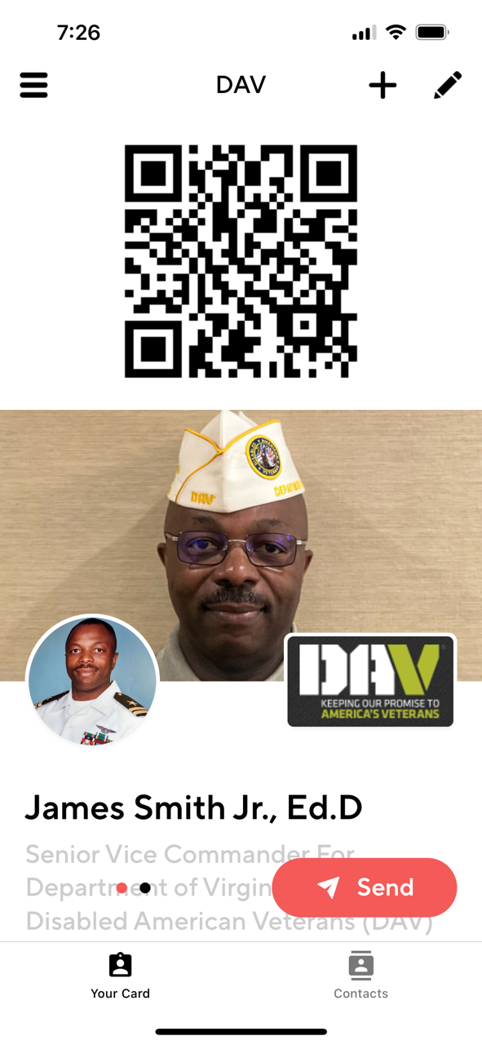

Slide 25
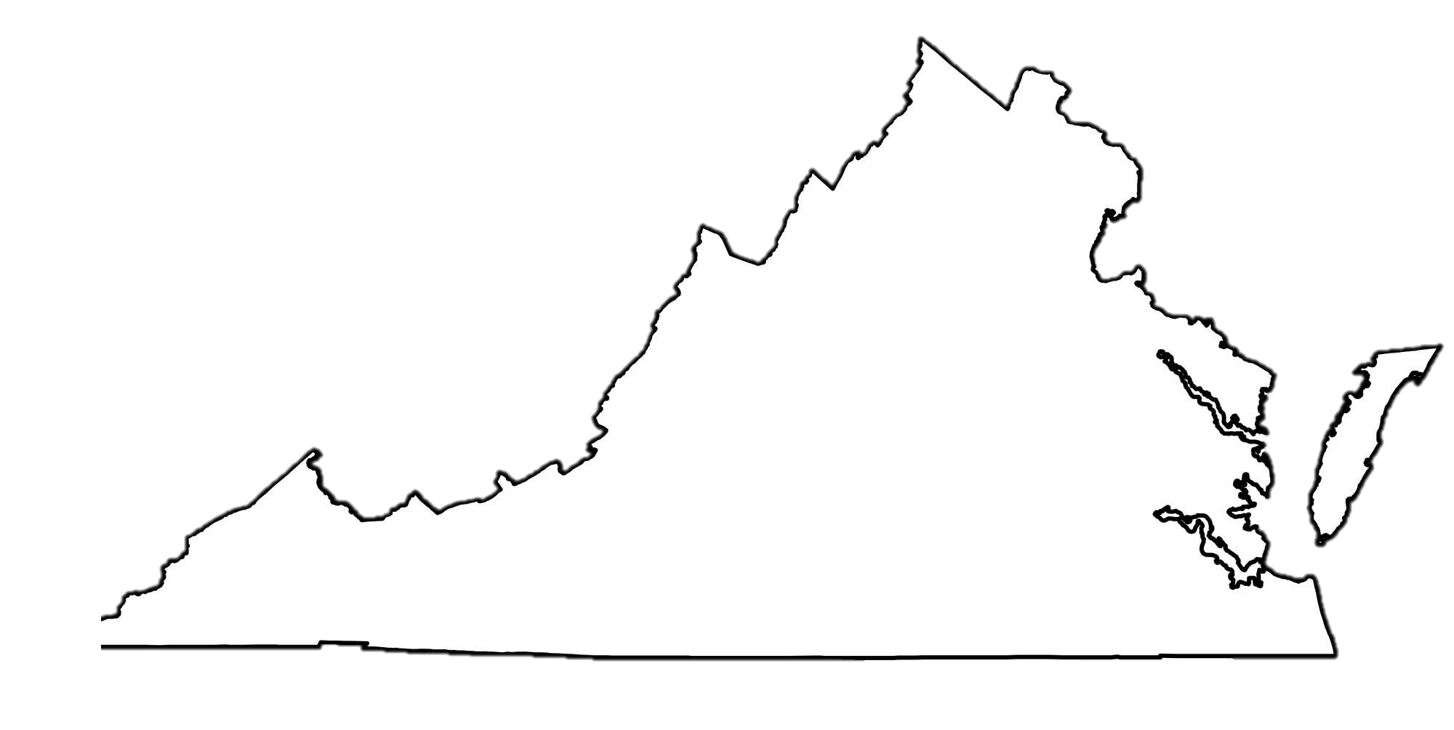
Department of Virginia Disabled American Veterans P.O. Box 7176 Roanoke, VA 24019-0147 540-206-2575 toll free: 866-706-5889 www.VirginiaDAV.org @DAVVirginia
© 2024 DAV-Department of Virginia. ALL RIGHTS RESERVED
No part of this work covered by the copyright herein may be reproduced or used in any form or by any means without permission from DAV-Department of Virginia

